Slide 1


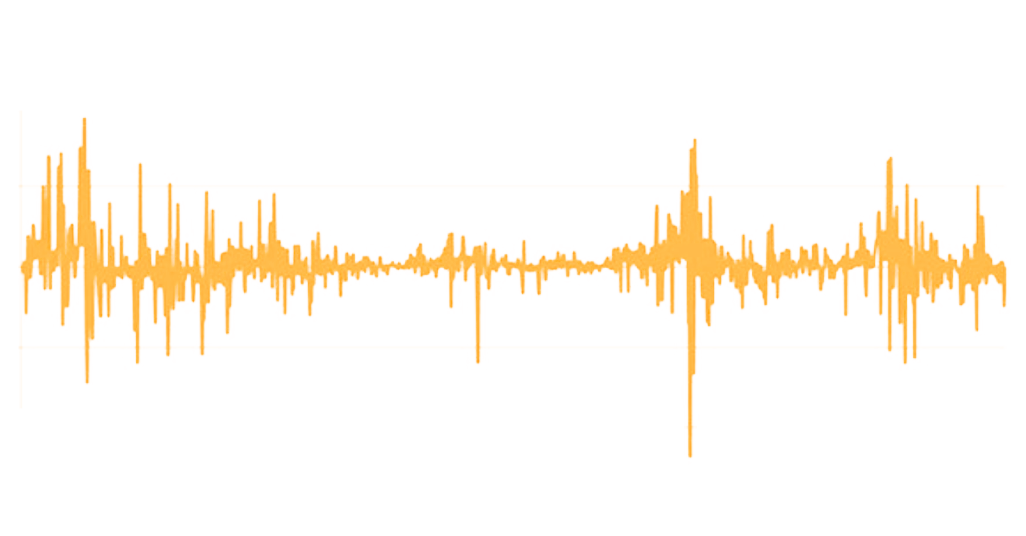
Epicenter Market Prominence Level Tracker
WHAT IS IT?
Epicenter Market Prominence Level Tracker is a Polkadot-based algorithmic stablecoin soft-pegged to $1. It uses the proven Hayek Money technique known as “rebasing” to attain the peg. In this design, the number of coins in a user’s wallet increase or decrease. If the market price* is $2, the wallet’s balance reduces 50%. Similarly, if the closing price is $0.50, the coin balance doubles.
1.60
1.40
Wallet balance decreases
1.20
EMPL PRICE ($)
1.00
0.80
Wallet balance increases
0.60
0.40
HOW DOES IT WORK?
EMPL accrues cash flows from transaction fees in the Epicenter ecosystem. These fund a “locked liquidity floor” of buyback guarantee funds as a “buyer of last resort” to recapitalize the system in the event of black swan scenarios. EMPL is designed to deliver boring, utility-like (yet consistently positive) returns over the long term.
The team, Epicenter Equity Corp, has a 7-year vesting schedule, ensuring their interests are aligned with token-holders over the long term.
*See whitepaper for our solution to the oracle problem
CONTACT
LEARN MORE
Patrick Moynihan CEO, Epic Funds, LLC
winning@epicfunds.io
https://empl.epic.tech
Institutional & HNWI enquiries: https://epicfunds.io
EMPL One Pager v0.2 DRAFT. 18th Feb 2021

